Slide 1






Welcome to Consumer Corner!
How much do I Pay? How do I choose?
What are options for Set Top Box?
Where to complain?
Toll Free
Getting best out of the Network

Slide 2
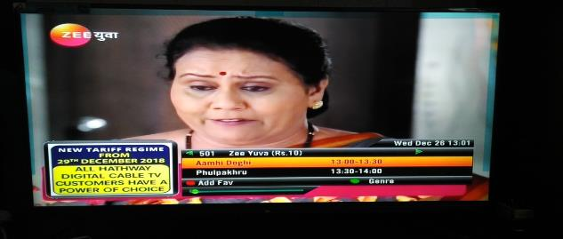


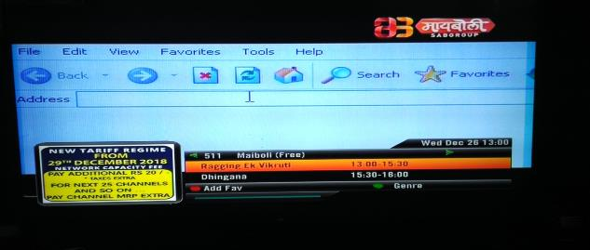

The New Way

Slide 3
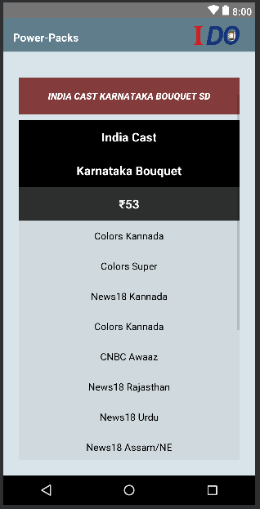

Illustration of Channels in Basic Bouquet
These are Channel Bouquets from which you can select as per your choice.

Slide 4
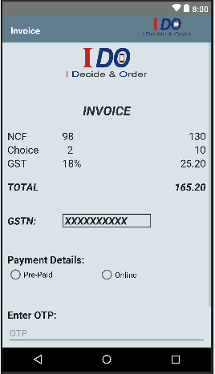



Illustration of Channel Selection in Basic Bouquet
Savings

Slide 5

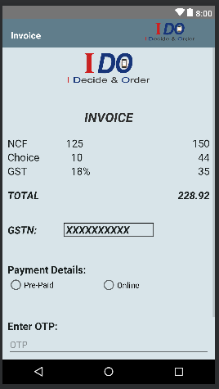
Illustration of Additional Channel Selection and Billing

Slide 6



The Basics and Your Rights

Slide 7



Other Charges Payable
then
Reactivation fee will be charged

Slide 8






Bills and Receipts

Slide 9
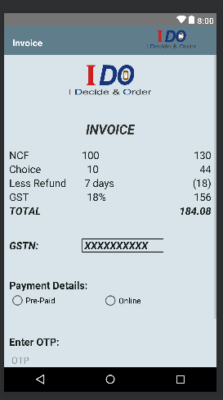



Service Breaks and Refunds
Unable to relay
Refund

Slide 10





Complaint against Content
Complaint On
www.IDOmytv.in

Slide 11





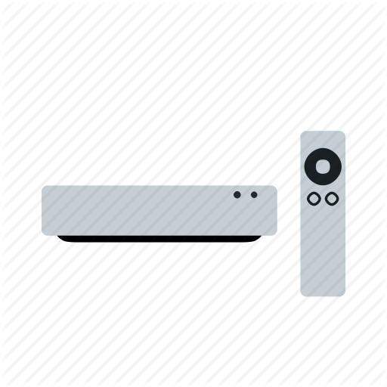

Set Top Box Related
BUY

Slide 12
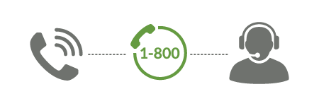
Customer Care Services

